Slide 1


ML-Driven Predictive Modeling of Steel Heat Treatment for Desired Mechanical Properties
MSE643 – Artificial Intelligence and Machine Learning in Materials Engineering
Course Instructor – Prof. Dr. Krishanu Biswas
Term Project
Neural Nexus
Mr. Kamal Verma
Mr. Viswa Prasad S V
Mr. Mohamed Asleem M
Mr. Zewudu Wondimagegne
Mr. Yohannes Tadesse
Mr. Arun Kumar Yadav
Mr. Mugilan T
Ms. Fazila Javid

Slide 2

Problem Statement
Different grades of Steel
Unavailability of steel grade with desired mechanical properties
Heat Treatment affects steel’s mechanical properties
Traditional Selection is time-consuming and based on trial and error
Objective
To develop an Artificial Neural Network (ANN) model that predicts the probability of achieving desired mechanical properties based on various heat treatment processes.
Reduce the time spent on selecting the heat treatment process
Reduce the wastage of resources

Slide 3
Data Collection
Data collection is the foundational step to gather information for training, validating, and testing ML models.
Influence: Quality, quantity, and diversity of data directly impact model accuracy and reliability.
Method: ANSYS Granta Selector 2024 R1 software utilized to generate various steel data.
Steel Data: Over 650 steel grades available in Granta Selector 2024 R1.
Software creates data for 20 steel grades at a time, resulting in approximately 33 datasets.
Properties: Each steel grade data includes diverse properties: Mechanical, H.T, electrical, chemical, composition, etc.
Focus: Mechanical properties (Yield strength) and heat treatment data consolidated into a single dataset.

Slide 4
Data Pre-Processing
Clean real-world noisy steel data from Excel "Steel_Data_Noisy.xlsx"
Extract relevant fields: Steel Grade, Condition, Yield Strength
Extracted keywords in Condition using regex (e.g., "annealed", "normalized")
Parsed modulus ranges (e.g., 200–210 GPa) into mean and std deviation
Generated 1000 synthetic samples per record using Normal Distribution (±std)
Export to new Excel file "Synthetic_Steel_Yield_Strength.xlsx".

Slide 5
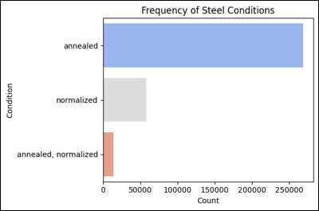
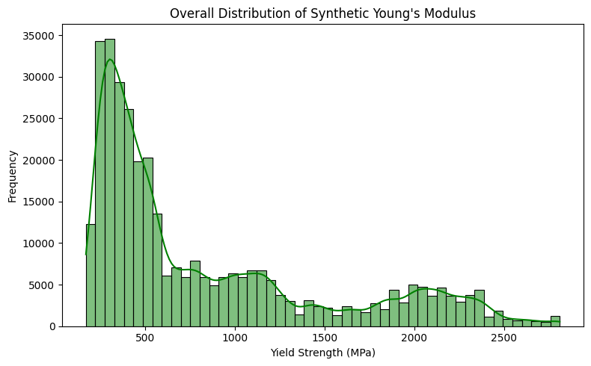
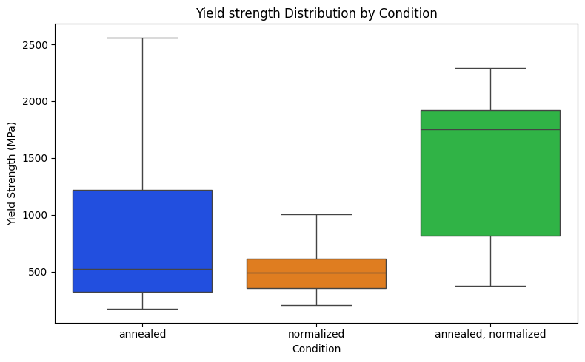
Data Visualization

Slide 6
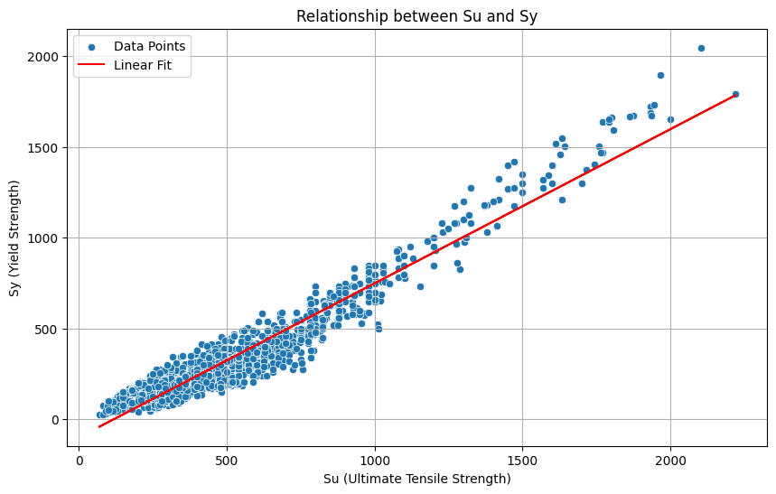
Sy and Su Relationship
Sy - Yield strength; Su - Ultimate Tensile strength
Plot Sy and Sy values from a different dataset that has direct values. "Data_Su_Sy.csv"
Fitting a linear regression model.
Sy ≈ 0.849 * Su - 100.119 (Linear)
R² score: 0.9170
This model helps if the desired feature is UTS

Slide 7
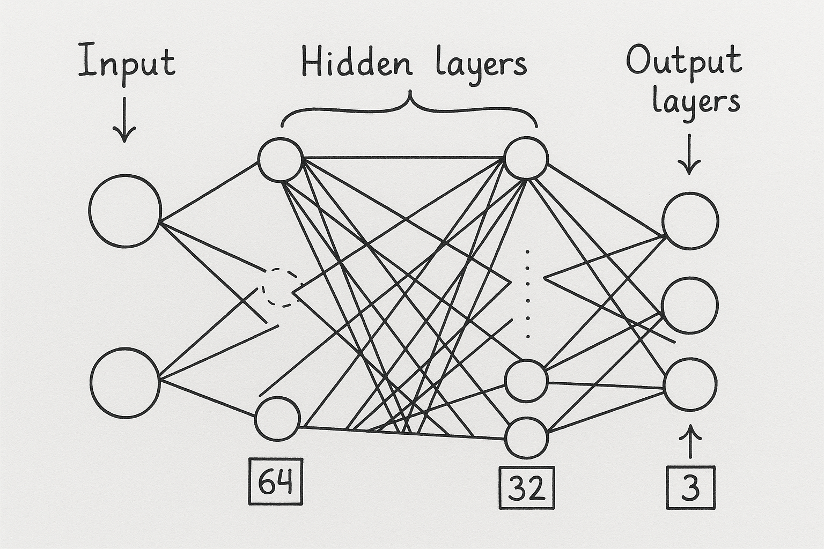
Model Training & Testing
Model Training | Model Testing
Label Encoding & Scaling Prepares features | Train-Test Split – Ensures fair evaluation
One-Hot Encoding of Target– Softmax compatibility | Evaluate on Test Set – Measures generalization
ModelCheckpoint – Saves best model | Save Model & Preprocessors – For future inference
Validation Split + Deep Layers – Prevents overfitting | Plot Accuracy/Loss – Diagnoses model performance
ANN Model:
1 input layer,
4 hidden layer(Activation='Relu’),
1 output layer (Activation='softmax')

Slide 8
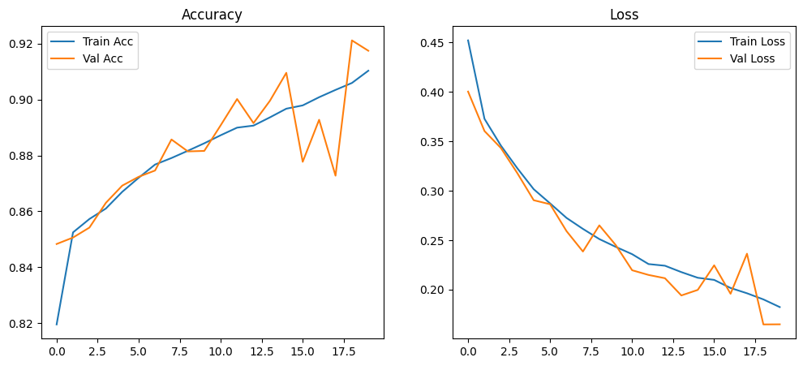
Model Evaluation
No major overfitting
Accuracy steadily increases, and loss decreases across epochs
Validation accuracy fluctuates slightly due to class imbalance

Slide 9
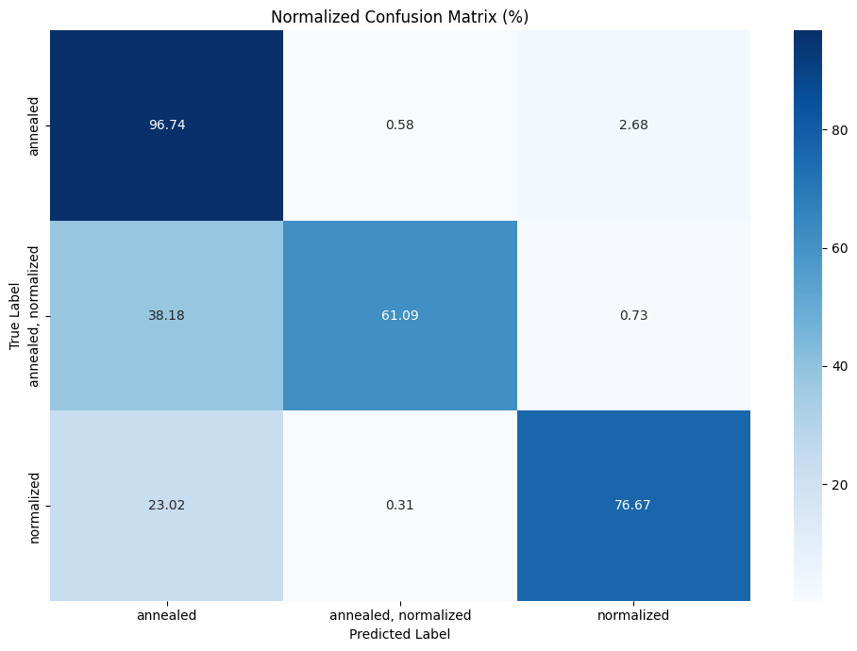
Model Evaluation
The confusion matrix highlights model performance across the three classes
The model:
Performs well for Annealed and Normalized classes
struggles with annealed, normalized

Slide 10
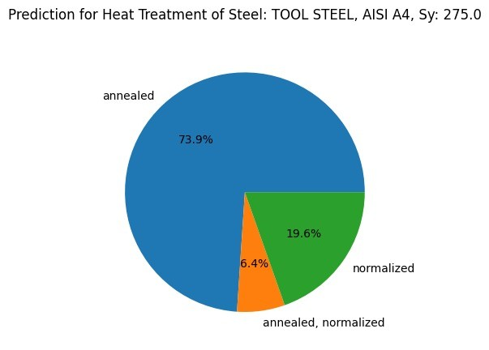
Results
Prediction:
Annealed: 73.9%
Normalized: 19.6%
Annealed & Normalized: 6.4%

Slide 11
Limitations
The model generalizes well to known data and provides high-confidence predictions.
However, the following limitations are encountered:
Class imbalance,
Reliance on a single feature (Sy), and
Occasional misclassifications between overlapping treatment classes.
Future Scope
Improvement can be done on various aspects
Input Feature addition
Composition, Different mechanical properties , Thermal properties
Prediction features addition ,Other heat treatment processes .etc

Slide 12
Conclusion
Built an ANN model to predict heat treatment from steel grade and yield strength
Achieved 90% accuracy on clean synthetic data
Accurate for ‘Annealed’ and ‘Normalized’ treatments
It demonstrates the use of ML in predicting the right heat treatment process for steel

Slide 13


